Slide 1


steganography GUI
Prepared by : Islam Gomaa 212495
Mahmoud Bahaa 210733
Presented To : DR. Manal Mostafa

Slide 2
Agenda
Introduction
Planning
Requirement Analysis
Design
Implementation
Testing

Slide 3
Introduction
Steganography is the art and science of hiding information by embedding messages within other.
It involves embedding data invisibly in an image, audio file, video, or other media.
A Graphical User Interface (GUI) uses visual elements like icons and menus to allow users to interact with devices, making technology more intuitive and accessible.

Slide 4
Plannig
Objective: Develop a secure and user-friendly steganography application for desktop environments that allows users to encode and decode messages within images.
Scope: The application is designed to operate on desktop
environments, specifically targeting systems that are
commonly used by user , such as Windows, macOS, and Linux.
Deliverables:
1. Project timeline and milestones chart.
2. Learn more about different steganography algorithms.
3. Initial GUI Design Mockups.
4. Resource Allocation for the project.

Slide 5
Requirement Analysis
Functional Requirements:
1. Image Handling: The application must support importing and exporting image files, specifically in formats like PNG, JPG.
2. Data Embedding: Users must be able to enter text that will be hidden within an image.
3. Data Extraction: The application must be able to decode hidden messages from images and display the extracted text to the user.
4. Save Functionality: Users should have the ability to save the modified image with the embedded data at a desired location.

Slide 6
Requirement Analysis (Cont.)
Non - Functional Requirements:
1. Performance: The application should perform encoding and decoding operations within a reasonable time frame.
2. Usability: The GUI should be intuitive and easy to use, requiring minimal learning curve for new users.
3. Scalability: The application should be designed in a way that it can be easily expanded to include more features.
5. Security: The application must securely embed data in images without risking data privacy or integrity.

Slide 7
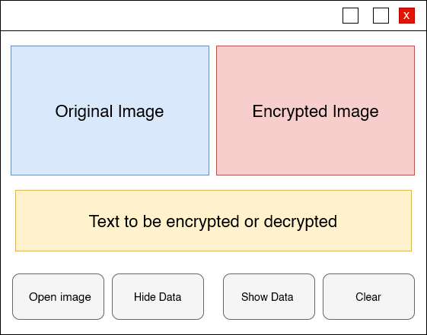
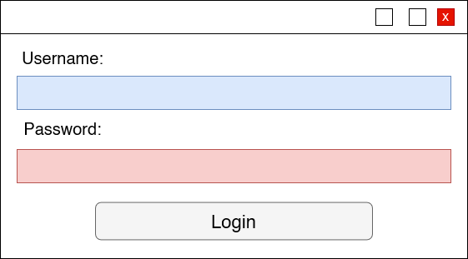
Design
2. steganography GUI page.
1. Login GUI page

Slide 8
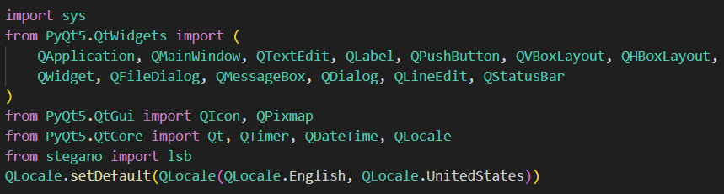
Implementation
1. Imports and Global Settings
Description: This section imports necessary modules from PyQt5 for creating the GUI, handling the application's logic, and formatting.

Slide 9
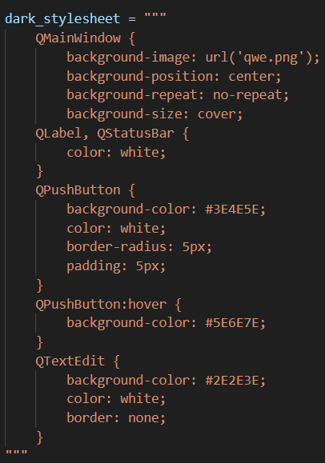
Implementation (Cont.)
2. Dark Blue Stylesheet
Description: Defines a CSS stylesheet for styling the PyQt5 widgets. This includes styles for the main window, labels, buttons, and text. Also, this lines of codes created for login page.

Slide 10
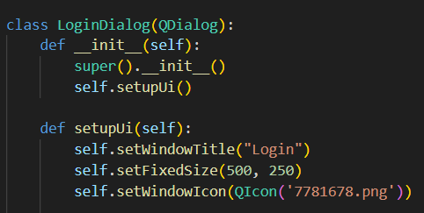
Implementation (Cont.)
3. Login page settings
Description: Defines login page class and its Constructor, then setup the GUI with window size and set window Icon.

Slide 11
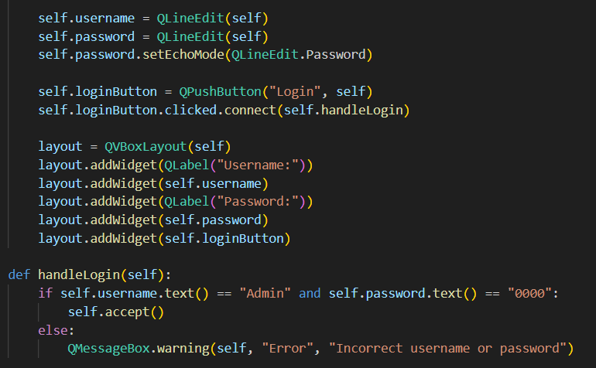
Implementation (Cont.)
4. Login Validation:
Description: The handleLogin method validates the credentials. If the username is "Admin" and the password is "0000", the dialog is accepted and closed; otherwise, a warning message pops up indicating incorrect credentials.

Slide 12
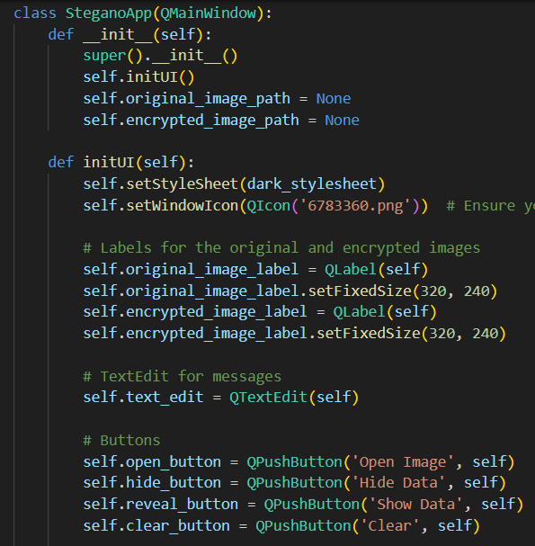
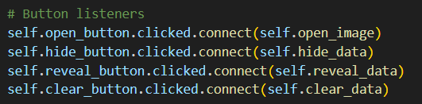
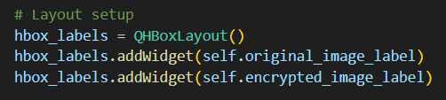
Implementation (Cont.)
5. Steganography GUI page
Description: Defines Steganography GUI page class and its Constructor, then setup the GUI with window size and set window Icon. Also, push button are defined.

Slide 13
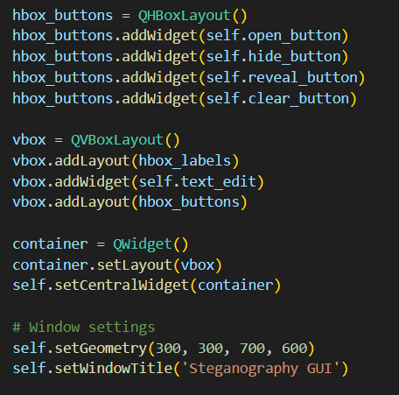
Implementation (Cont.)
5. Steganography GUI page
addWidget: Four buttons
are added to this layout.
vbox creation: A vertical box layout (QVBoxLayout) is created to arrange widgets vertically.
setCentralWidget: The container widget is usually the main content area of a QMainWindow.

Slide 14
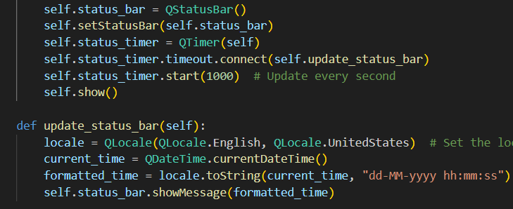
Implementation (Cont.)
6. Time and date
Description: updates time and date using method update_stuatus_bar also update time every second. Therefore, using English for represents it.

Slide 15
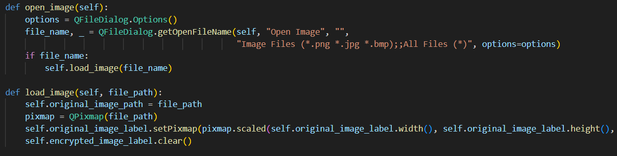
Implementation (Cont.)
7. Open, Load, and save image
Description: in this lines of code the user able to open image with common extensions, also load images to encrypt or decrypt.

Slide 16
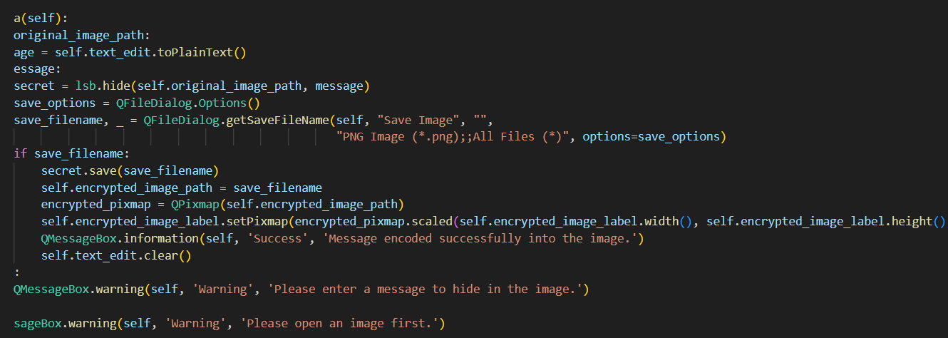
Implementation (Cont.)
7. Open, Load, and save image

Slide 17
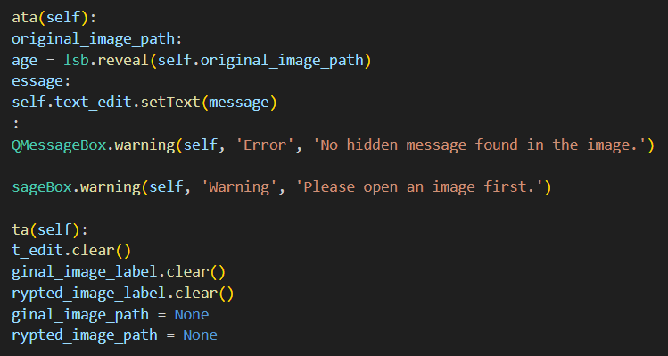
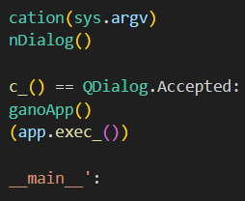
Implementation (Cont.)
8. Clean option and execution

Slide 18
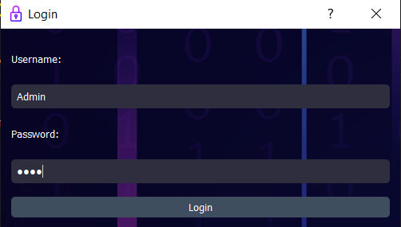
Screenhot of execution
1. Login GUI page

Slide 19
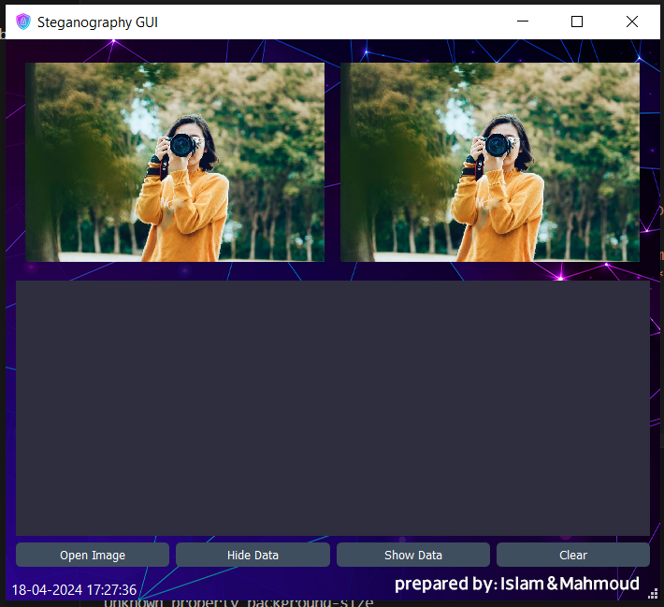
Screenhot of execution (Cont.)
2. steganography GUI page

Slide 20

Testing
Positive test cases
Negative test cases
1. Login successfully with correct username and password.
1. Enter wrong username or wrong password.
2. encryption and decryption data form images with different extensions.
2. Press any option without making all steps correctly such as hide data without upload image first.

Slide 21
References
1
Kaspersky (2023) What is steganography? definition and explanation, www.kaspersky.com. Available at: https://www.kaspersky.com/resource-center/definitions/what-is-steganography (Accessed: 18 April 2024).
2
Iwugo, D. (2023) What is steganography? how to hide data inside data, freeCodeCamp.org. Available at: https://www.freecodecamp.org/news/what-is-steganography-hide-data-inside-data/ (Accessed: 18 April 2024).
3
Create python guis with pyqt5 -- simple guis to full apps (2023) Python GUIs. Available at: https://www.pythonguis.com/pyqt5/ (Accessed: 18 April 2024).

Slide 22
Thank you!
Any questions

